Slide 1

Cyclistic
Bike-Share
Presented by: Rishabh Sharma
Last Updated: September 12th, 2024

Slide 2
Table of Content:
Data Cleaning or Manipulation
Key Findings and Visualisation
Top recommendations

Slide 3
Data Cleaning or Manipulation (Rstudio)
Removing rows where the start time or end time of the rides were “NA”.
Removing rows where the start time is later than the end time of the rides.
Splitting the start and end times column into date and time.
Calculating the ride duration using the start date and start time as we need to compensate for the date change instead of using only start and end times.
Converting the dates and time to Integers for calculations.
Merging and Rearranging according to start date and time for each month.
Filtering the data by season for visualisation.

Slide 4
Key Findings and Visualisation
There is significant increase in the ride durations from the month of May to November.
The total ride duration peaks for the month of July and is the lowest for the month of February.
The ride duration for Casual riders is significantly Greater for the month of May to November.
The ride durations are low during the Winter season.

Slide 5
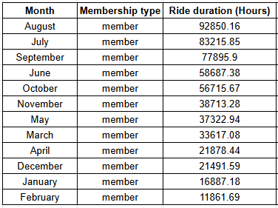
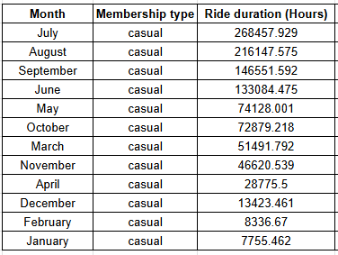
Ride Duration in Hours for total duration each month arranged in Descending order for Member’s and Casual riders.

Slide 6
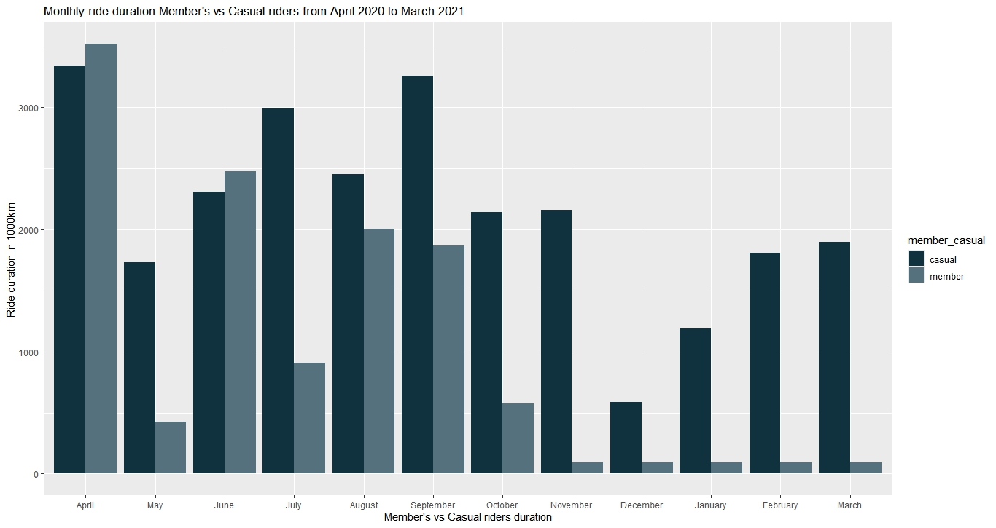
Ride Duration in 1000 secs for total duration each month for Member’s and Casual riders.

Slide 7
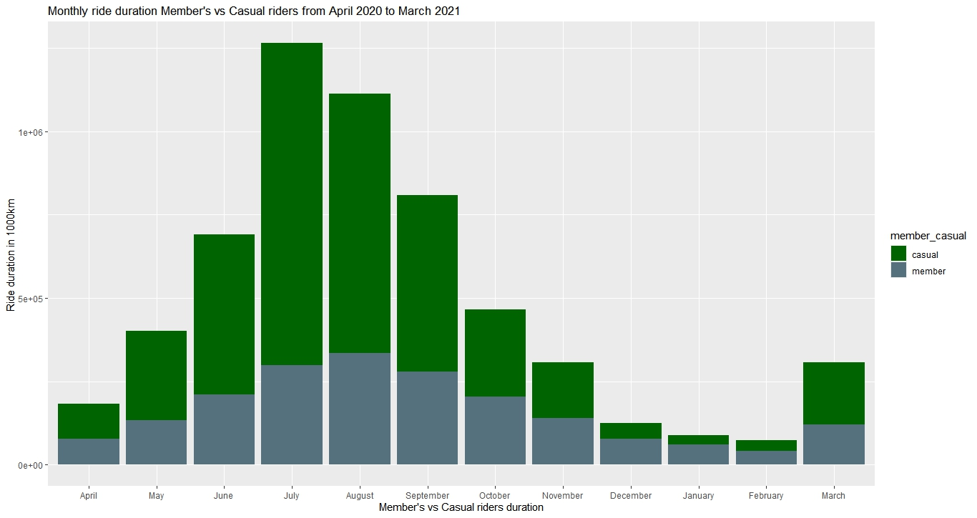
Ride Duration in 1000 secs for total duration each month for Member’s and Casual riders.

Slide 8
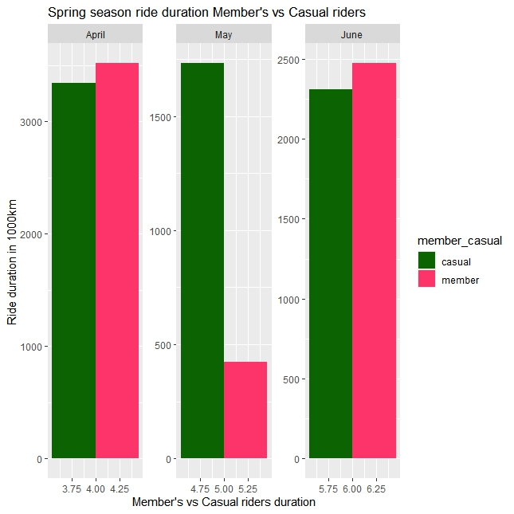
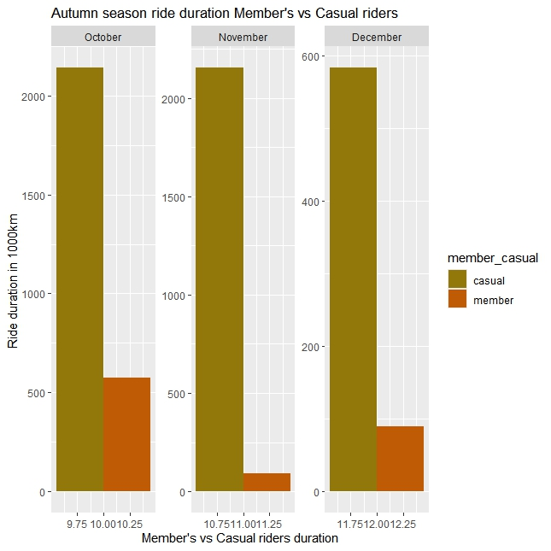
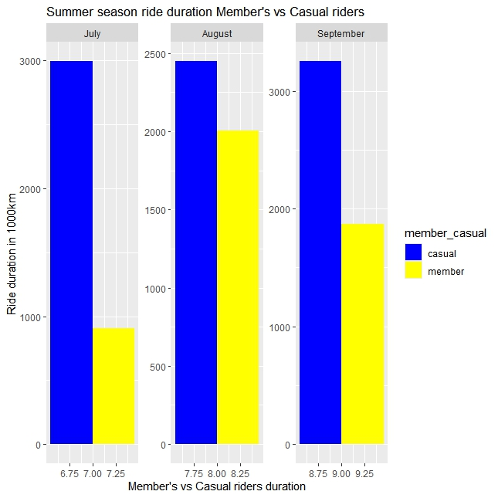
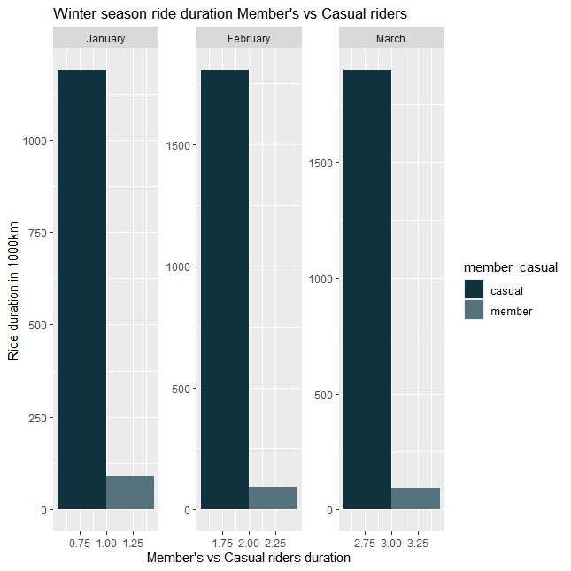
Season wise comparison for total time duration in 1000 seconds for Member’s and Casual riders.

Slide 9
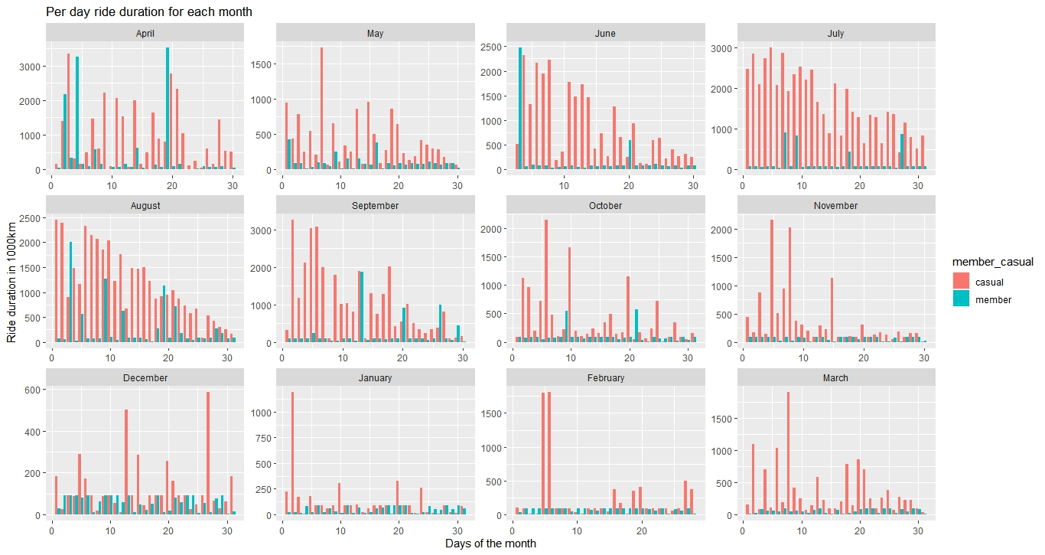
Ride Duration in 1000 secs for total duration each Day from April 2020 to March 2021 for Member’s and Casual riders.

Slide 10
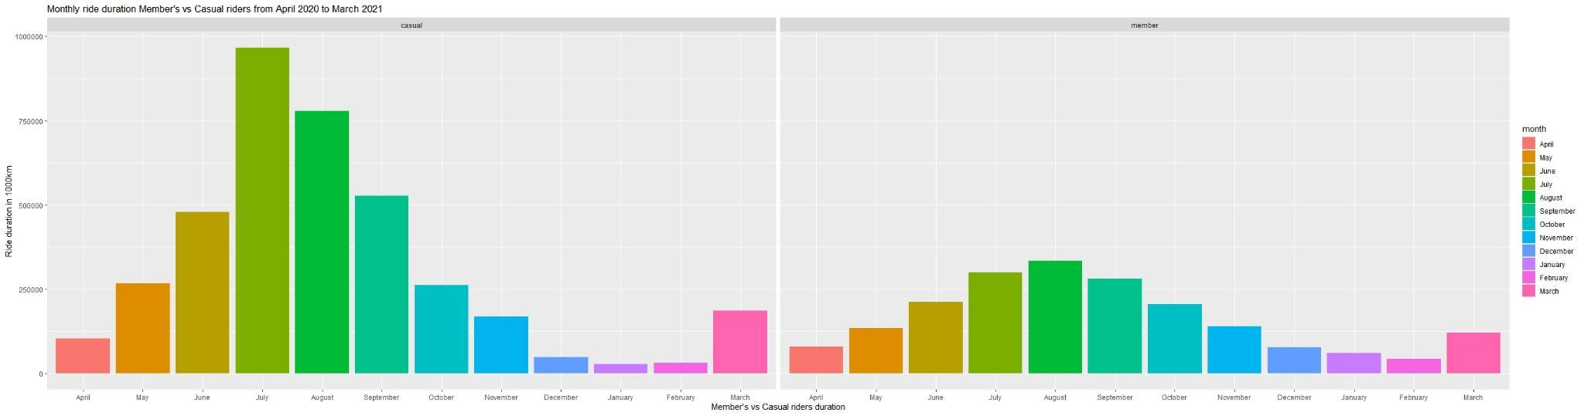
Ride Duration in 1000 secs from April 2020 to March 2021 for Member’s and Casual riders.

Slide 11
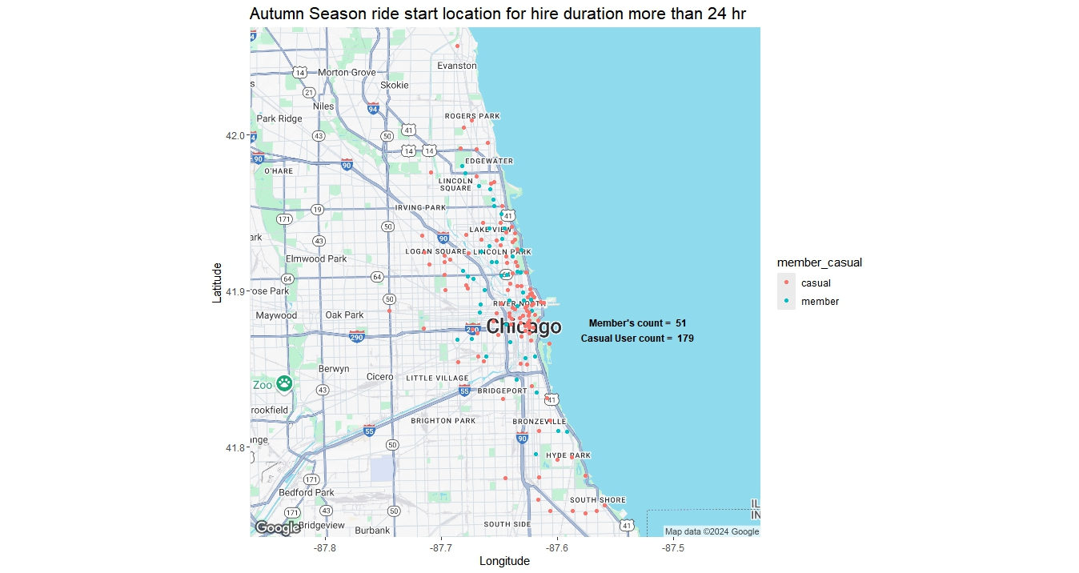
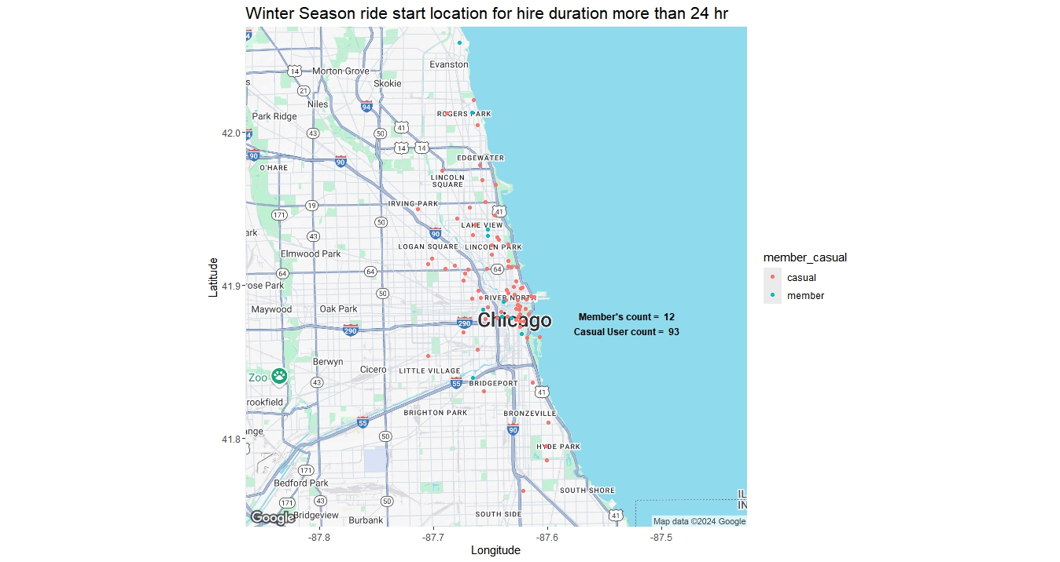
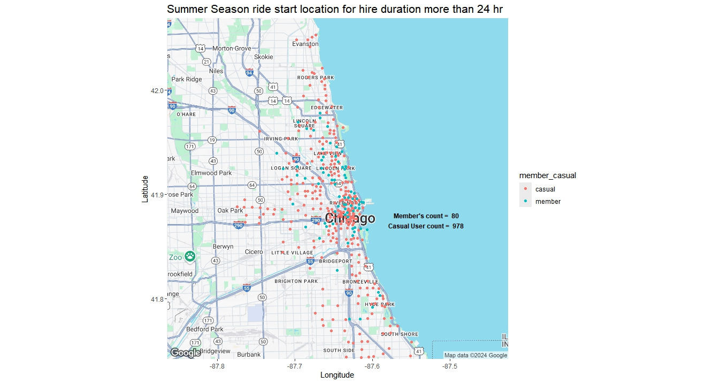

Season wise visualisation of Start location for Ride Duration more than 24 hours for Member’s and Casual riders.

Slide 12
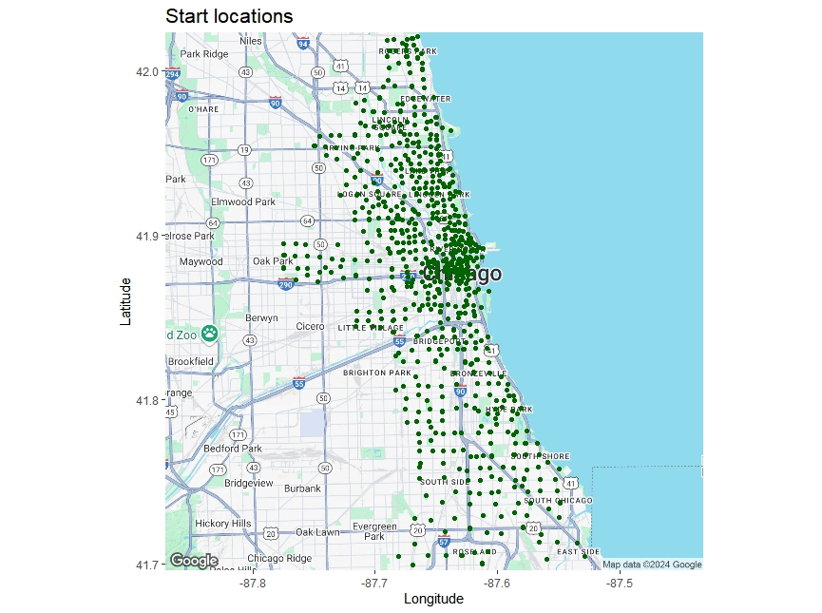
All 1259 Start Location for the Bike-Share service

Slide 13
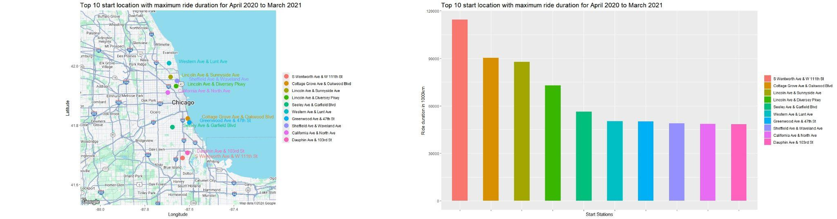
Top 10 Start Locations for Maximum ride duration and Total ride duration in 1000 seconds for each Location.

Slide 14
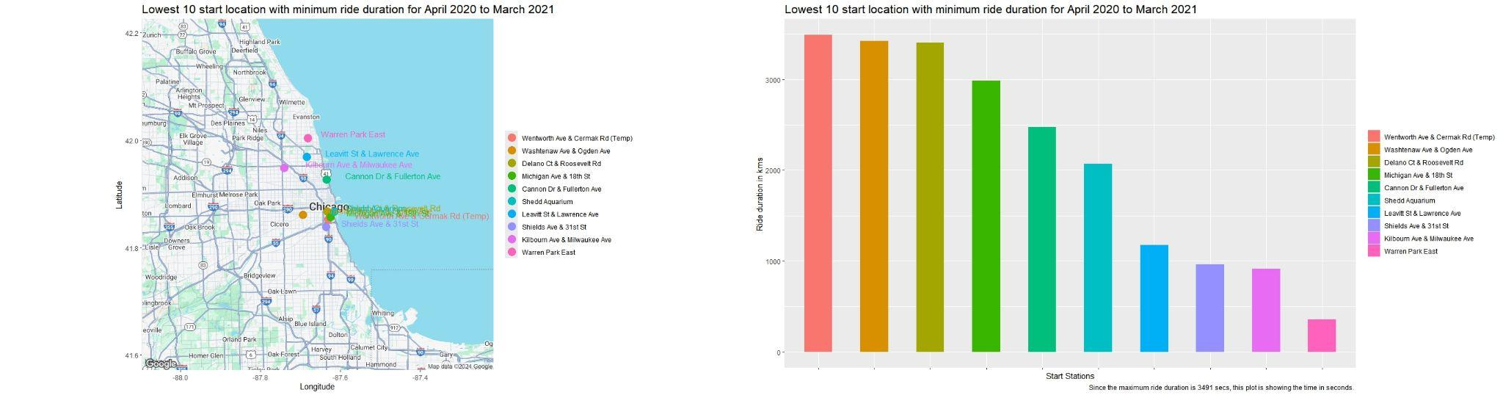
Top 10 Start Locations for Minimum ride durations and Total ride duration in 1000 seconds for each Location.

Slide 15
Top recommendations
Creating awareness about the health and environment benefits of using bikes and electric scooters.
Introducing promotions during the Winter seasons for rides helping move the Casual riders to become Members.
Introducing additional features for Members allowing them to gather insights for their rides such as Calories burnt, ride terrain, weather updates.
Monitoring and altering the number of bikes in locations were the bikes are more frequently hired.
Giving incentives to rides like additional discounts and promotions if they ride the bike above a certain distance.
Reserving bike at prime hiring location for members for convenience.

